Slide 1

4.6 M
1.3 M
DIABETES T1 WORLDWIDE
Notes:
ADA: 40,000 people receive a type 1 diagnosis each year in the United States.
ADA; 237 Bilion diret cost 2017 in US
€27.4/week for T1DM

Slide 2

4.6 M
1.3 M
5.8 B
DIABETES T1 WORLDWIDE
Notes:
ADA: 40,000 people receive a type 1 diagnosis each year in the United States.
ADA; 237 Bilion diret cost 2017 in US
2.4 billion euros cost for hospital for complications

Slide 3
Why is it important
Carbohydrate counting is a proven effective method to improve diabetic diet management¹
Monitoring activities are problematic for teenagers²
Complications of ‘bad’ diet diabetic in teens include³
$ 2.4 B EU total cost of complications due to hospitalization and home visits.
hyperglycemia
hypoglycemia
ketoacidosis
Notes:
Close story. Problem teenager. They don’t commit to monitoring.
Mayer-Davis EJ, Nichols M, Liese AD, Bell RA, Dabelea DM, Johansen JM, Pihoker C, Rodriguez BL, Thomas J, Williams D. Dietary intake among youth with diabetes: the SEARCH for Diabetes in Youth Study. J Am Diet Assoc. 2006;106:689–697.

Slide 4















Business Model Canvas
KEY PARTNER
KEY ACTIVITIES
VALUE PROPOSITIIONS
CUSTOMER RELATIONSHIP
CUSTOMER SEGMENTS
Diabetes Patients Organisations
Sensor producers
Development Company
Hospitals
Primary H-care System
Platform development
Community engagement
Champions
Pilot
Improving the experience of counting carbohydrates through personal assistant;
Decrease time spent for counting;
Reduced effort for counting;
Accuracy and accessibility
Integration with CGM and insulin pump;
Prevention of future complications;
Personal assistance (Chatbot);
Web platform – newsletter;
Community;
Symposium;
Europe market
Diabetes type 1 patients
Teenagers, over 15 years old,
KEY RESOURCES
CHANNELS
Human resources (Developers, Engineer, M.D.)
Sensors, Database, Mobile application, CRM.
GP (General Practitioner)
Social Platform; International Diabetes Patients Organisations;
COST STRUCTURE
REVENUE STREAMS
Developing platform
Marketing activities
Human resources costs
Data selling;
Cloud software
Software subscription:
Premium subscription;
Basic subscription;
Customize subscription;

Slide 5

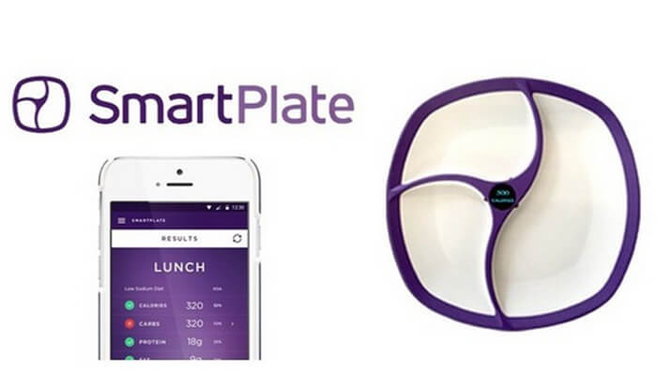


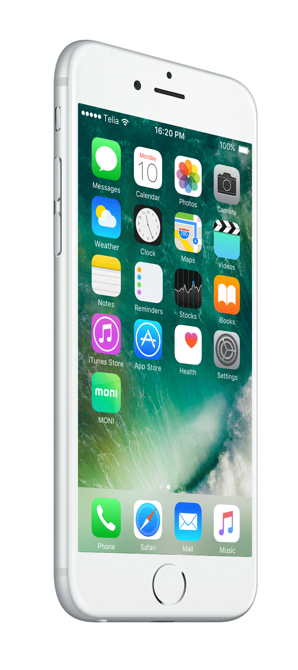
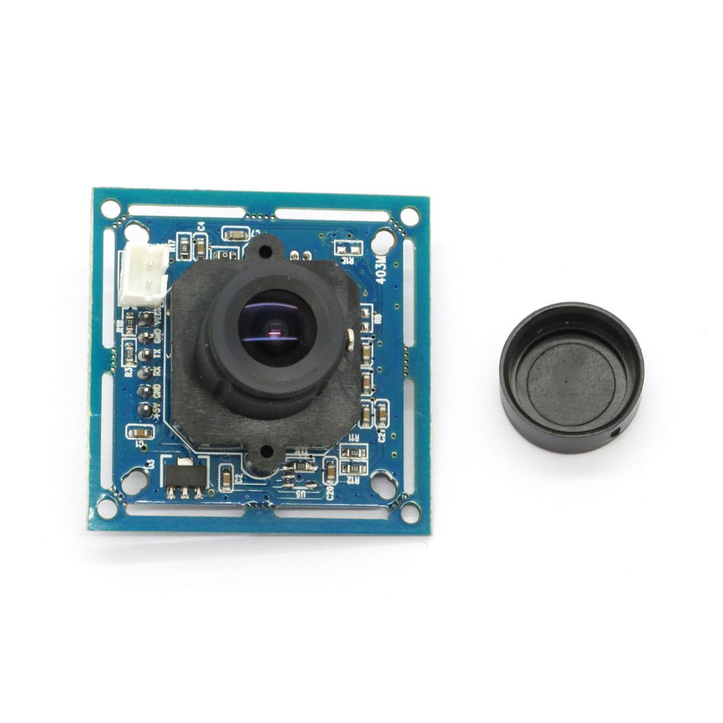


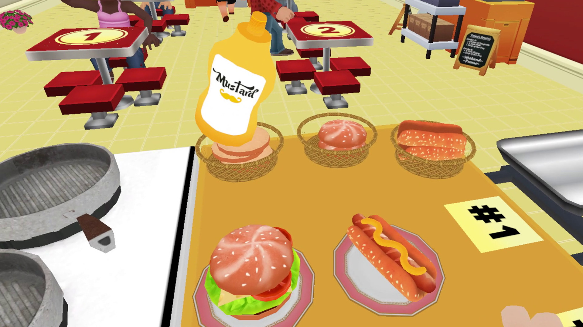

Block 5432

Slide 6


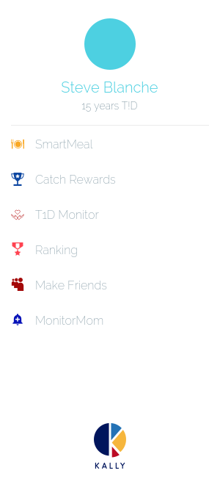

Slide 7

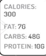

Slide 8

